Slide 1

Find Your Next Speakeasy
Patrick Matlick
Lauren Taft
Zach Lighton

Slide 2
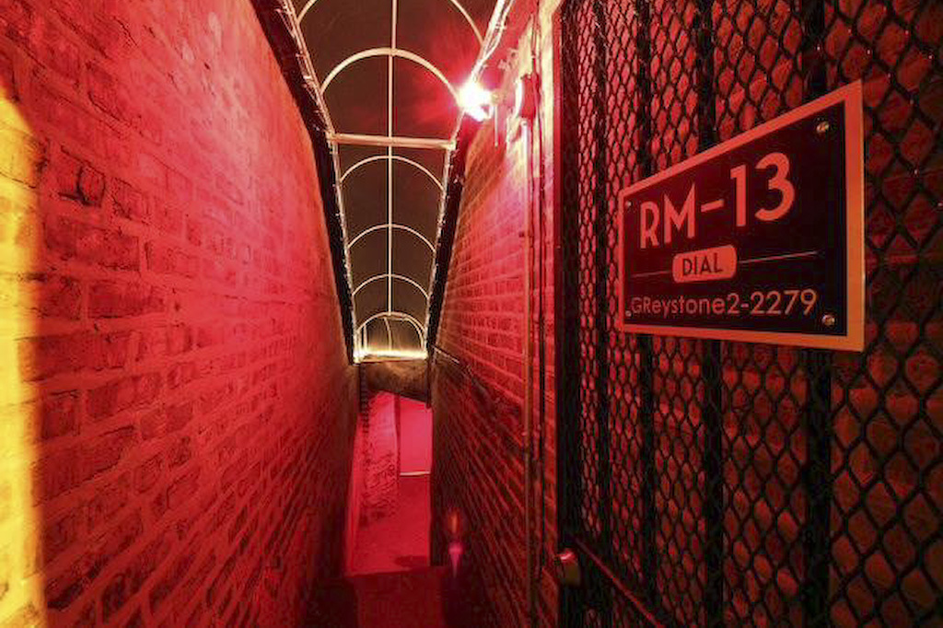
Are Speakeasies really a secret?
Specific Question/Hypothesis?
How popular are speakeasies in the United States?
Do speakeasies only exist only in major cities?
What is the average popularity rating of speakeasies by state?

Slide 3
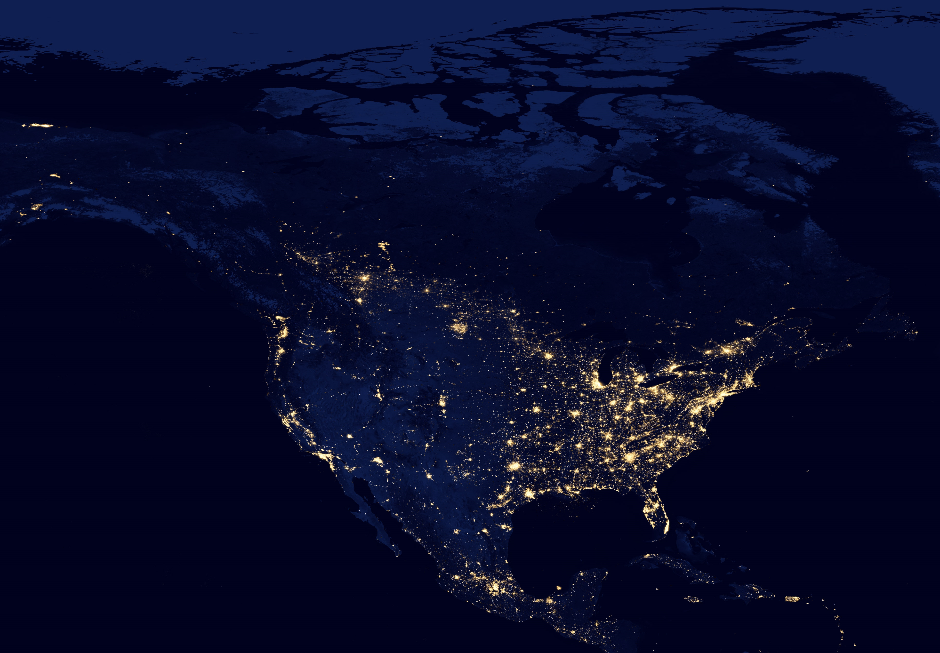
Data Source(s)
Google Maps API
City and State Names
Longitude and Latitude data
Yelp API
Speakeasy Businesses
Rating
Price points

Slide 4
Challenges
Problem 1 : Originally, the scope of our project was on the subject of crime data, drug abuse and rehabilitation facilities. Unfortunately, finding a geolocated crime database with any sort of drug categorization proved to be challenging.
We decided to change course and came up with a fun alternative; to research Speakeasies using the Yelp API.
Problem 2: There are a lot more speakeasies that exist than we had anticipated which made plotting a map quite difficult to accomplish on our laptops. We ran into the reoccurring situation of our computers running out of memory.
We decided to filter out some of the smaller cities, based on population, for our map plots and went with a more focused view of the data to be able to plot.

Slide 5
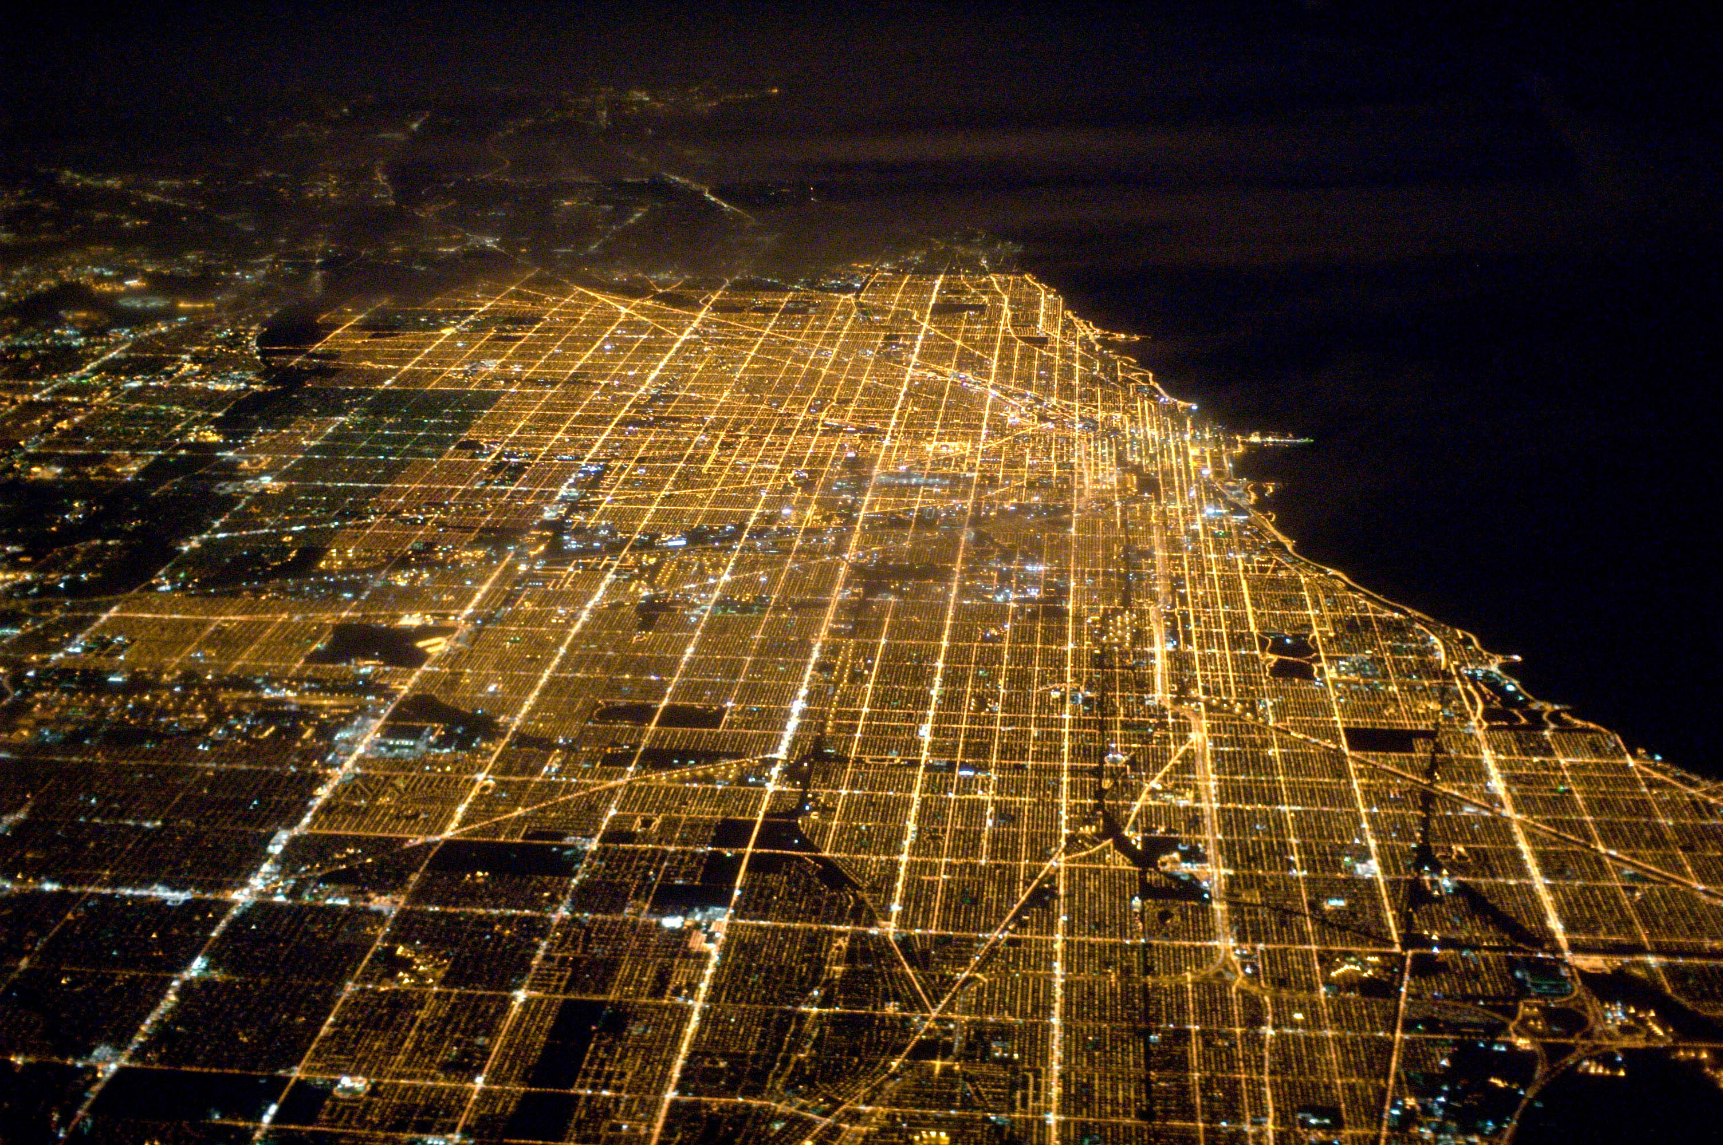

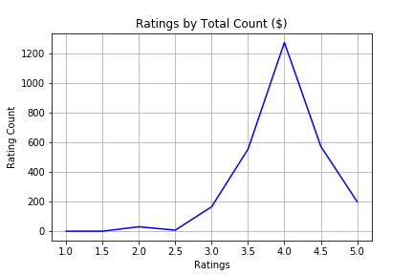
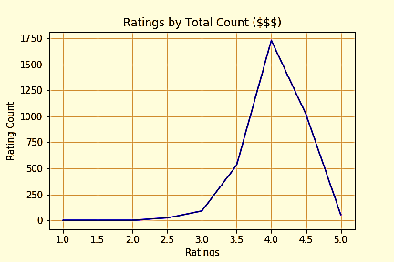
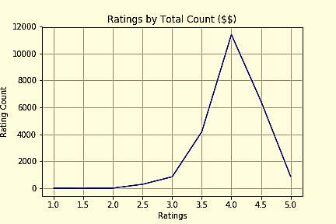
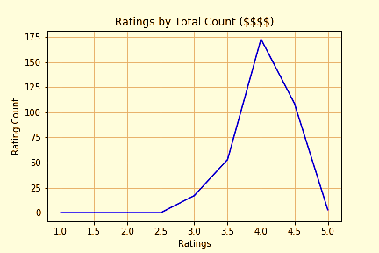
Question (1)
Is their any correlation to the overall rating of a speakeasy based on the price point?
The Correlation Coefficient between Ratings and Price is -0.06435.
Notes:
The correlation coefficient between Ratings and Price is -0.06435154253685545 which tells us that there is almost no relationship between Price and Rating statistically.

Slide 6
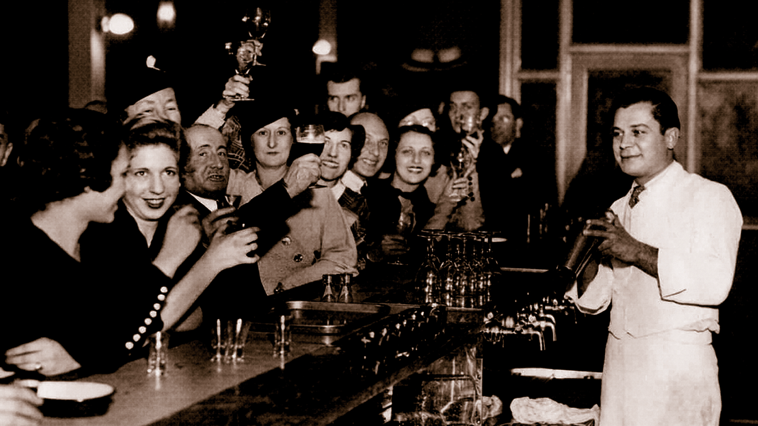
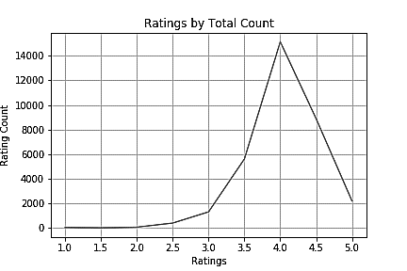
Question (2)
What are the majority of US Speakeasies rated?
Notes:
Based on 33,602 speakeasies in the United States, we found out that majority of speakeasies have a rating of 4.0 or higher.

Slide 7
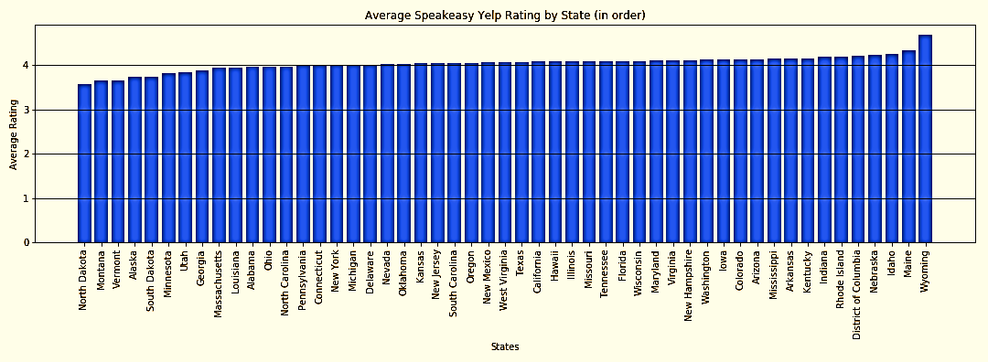
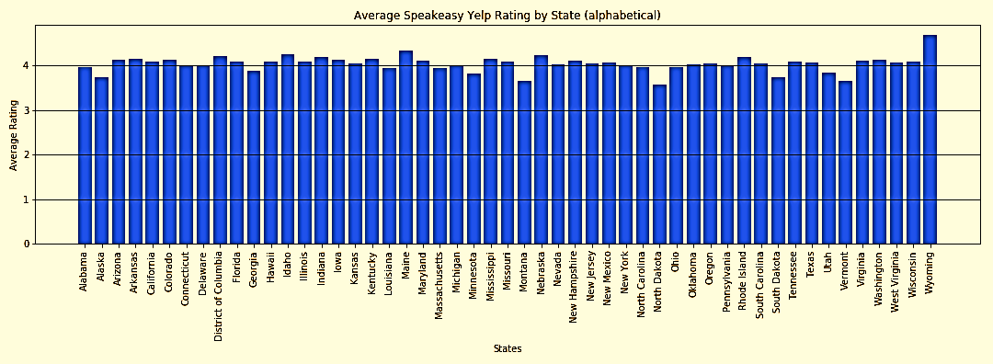
Question (3)
What is the average rating of a Speakeasy by state?
Wyoming? Who would-a thought!
Notes:
To our surprise, we found that their isn’t a vast difference in how popular speakeasies are by state. Most of the data shows us that speakeasies are highly rated throughout the US.

Slide 8
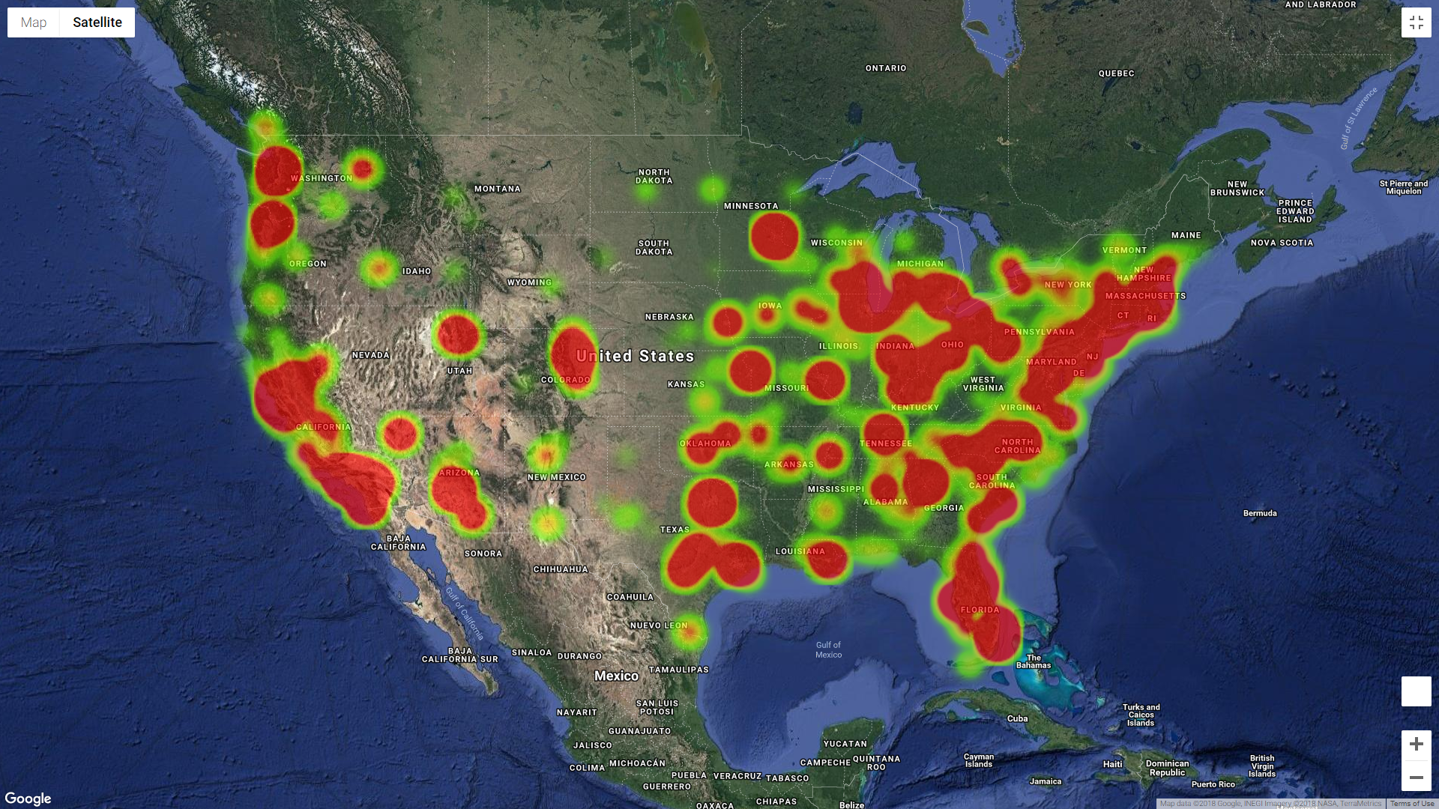
Question (4)
Where are the majority of speakeasies located?
Notes:
The difference between the two heat maps is that the both represent all speakeasies but the "weighted" one gives more "heat" to the areas with higher ranked and higher count of speakeasies.

Slide 9
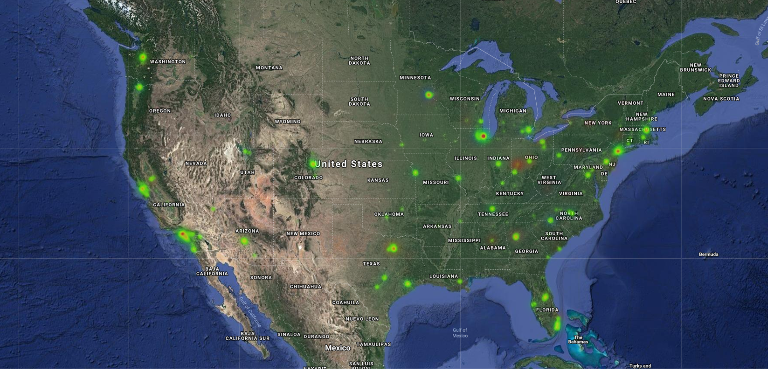
Question (5) : What cities are the best for speakeasies?
Notes:
This allows us to see which Speakeasies in cities may be best to go to.

Slide 10

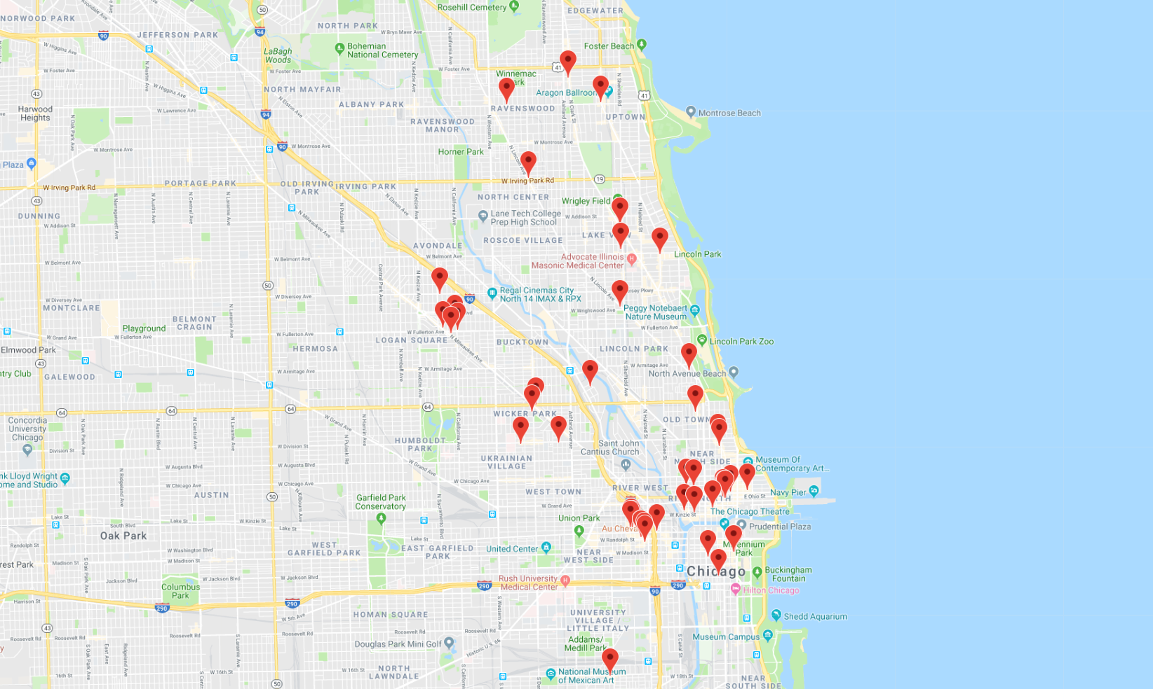
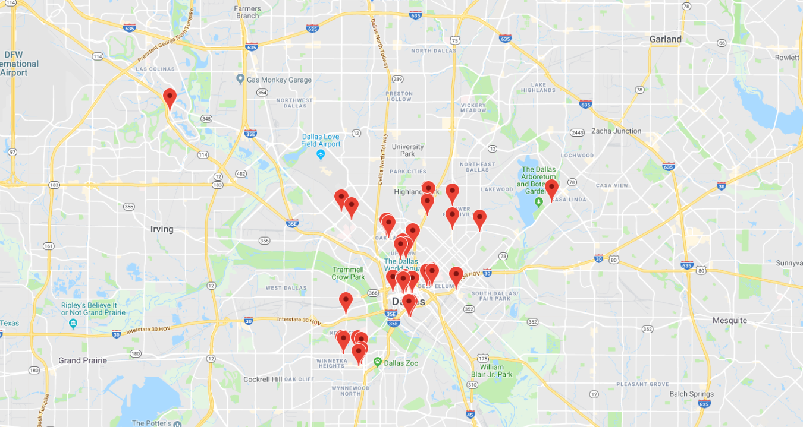
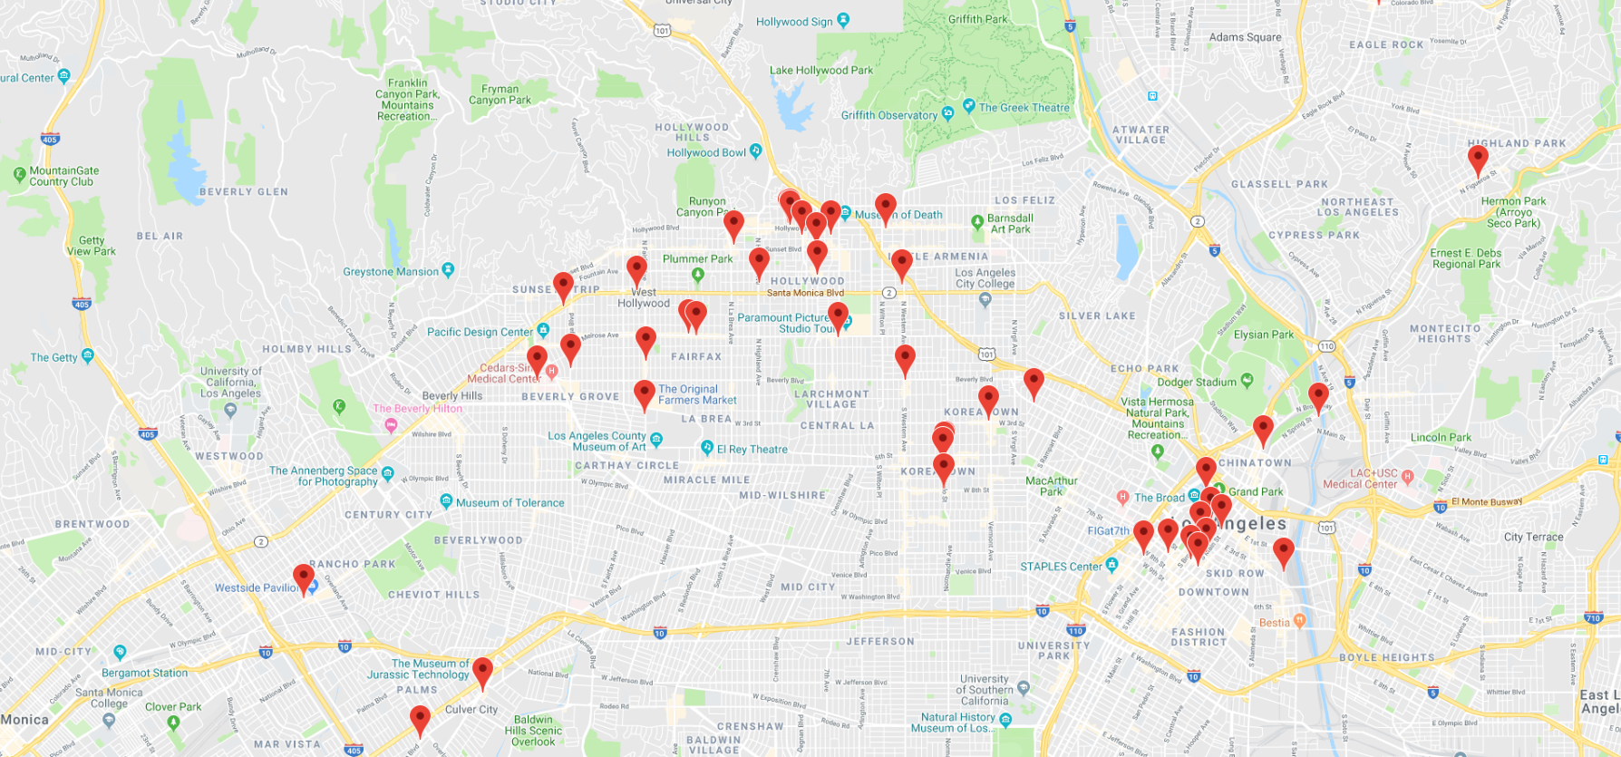
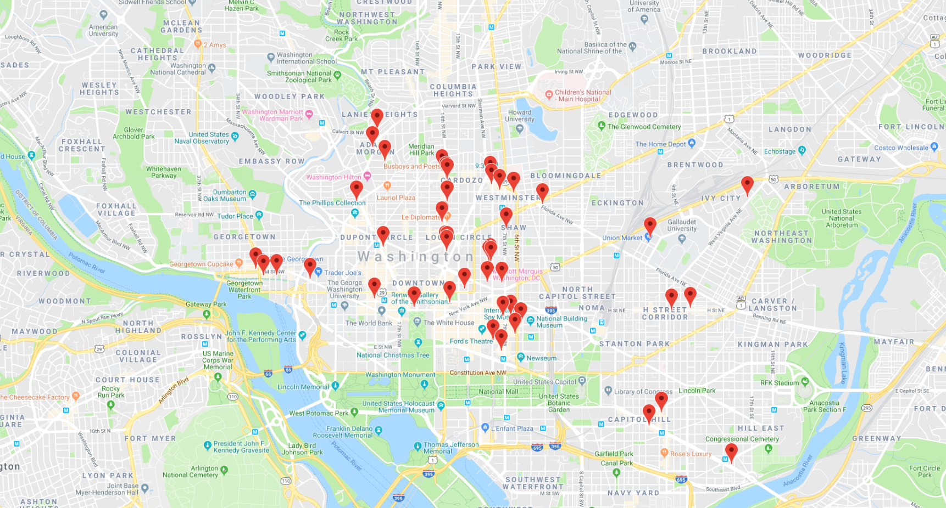
Question (6) : Where are they in the city?
Chicago
Dallas
Hollywood
Washington DC
LA
Notes:
We found that Speakeasies are most often located in a cities downtown area rather than being scattered evenly across counties, towns or neighborhoods.

Slide 11
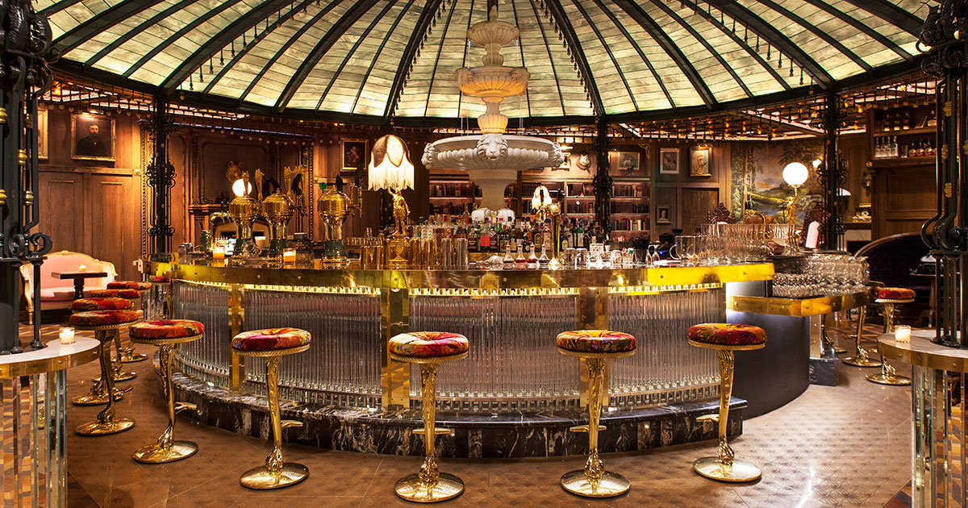
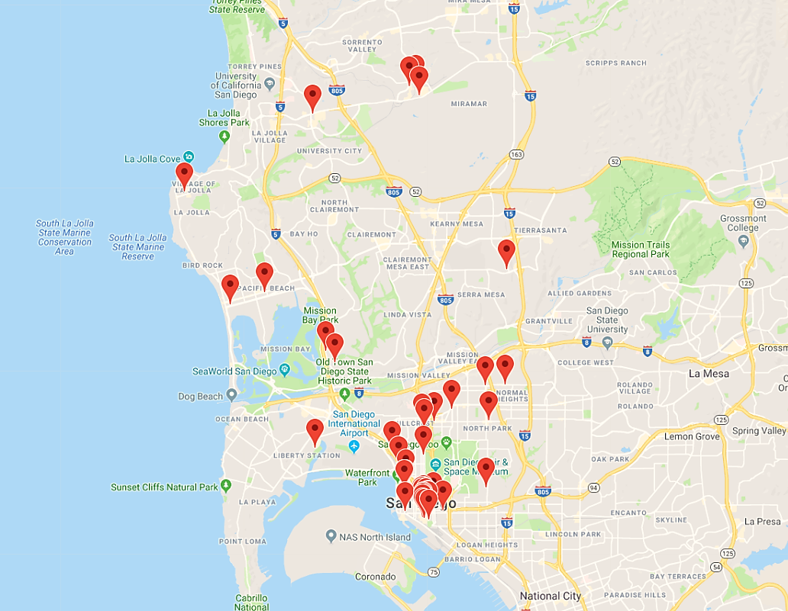
Speakeasies in San Diego
Raised by Wolves
Notes:
If your thinking you might want to check out a Speakeasy in San Diego stomping grounds, there are some great options such as this little gem “Raised by Wolves”

Slide 12
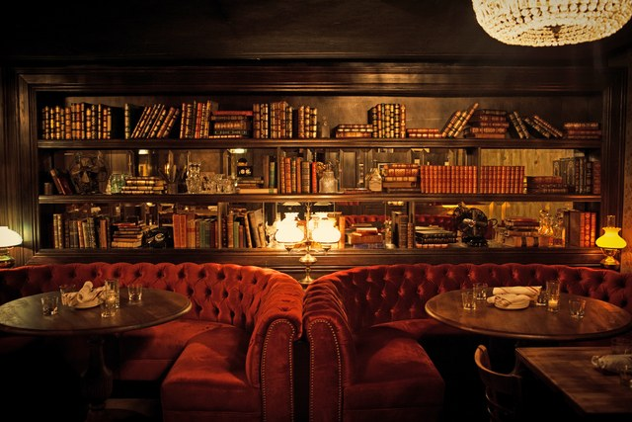
Conclusions
Summarize your discoveries
- Speakeasies are more central to the downtown city areas, especially in larger cities.
-There is almost no relationship between Price and Rating statistically.
-Speakeasies are ranked pretty high with majority rank being 4.0 or higher
Comment on your work
I feel good about the change we made and what we were able to accomplish with the data we were able to collect on Speakeasies
How could you improve your analysis in the future?
I would have liked to incorporate population, theme, and gender popularity into the analysis if there was more time.

Slide 13
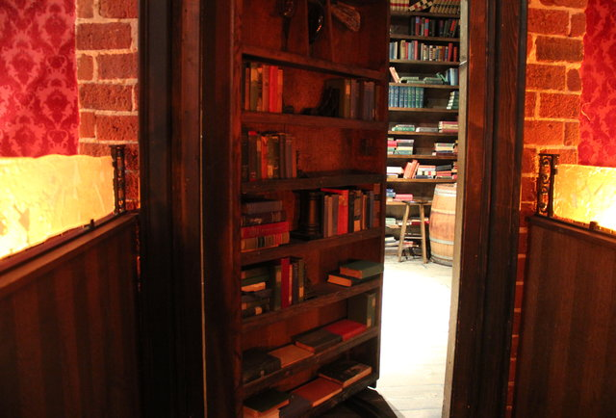
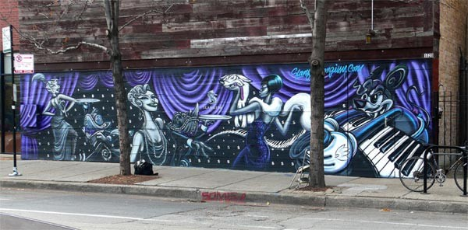
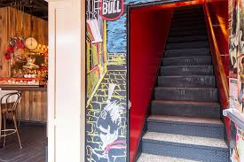
Find an awesome Speakeasy!
Your Next Assignment..

Slide 14
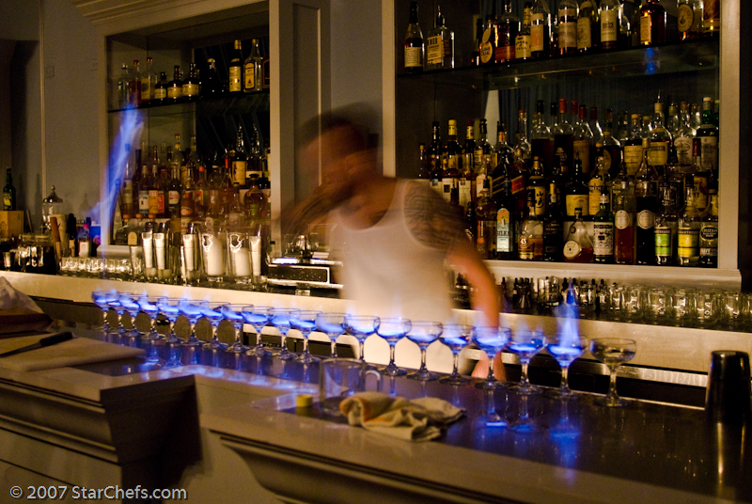

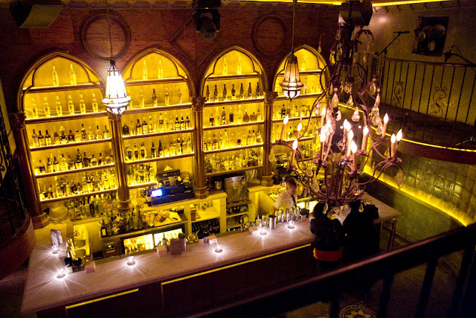
You might be surprised what you find behind the hidden door

